Slide 1
Software Engineering Project: Testing
.
Project Title:
A full stack web application to provide daily essentials including medicines and stationaries.

Slide 2
For testing, We have used White Box Testing and unit testing.
For testing this web app we have taken the help of Jest and SuperTest which is a node module generally used for testing MERN web applications

Slide 3
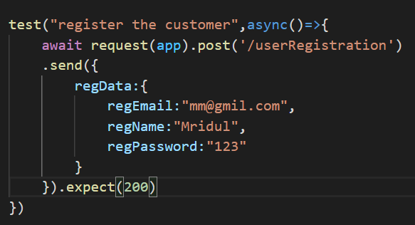
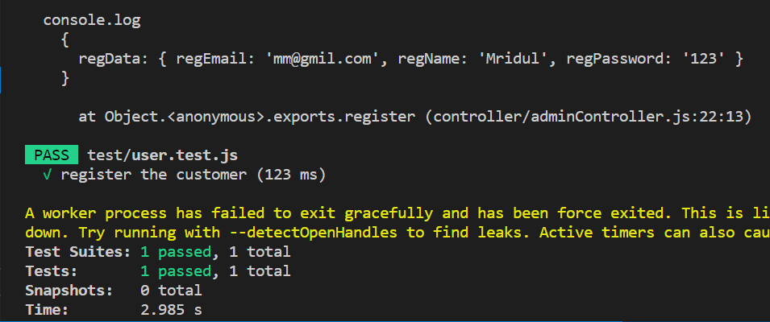
Here, the registration for the customers on this app is being tested. After testing, it is found that the customer can successfully register .
Test Case
Output

Slide 4
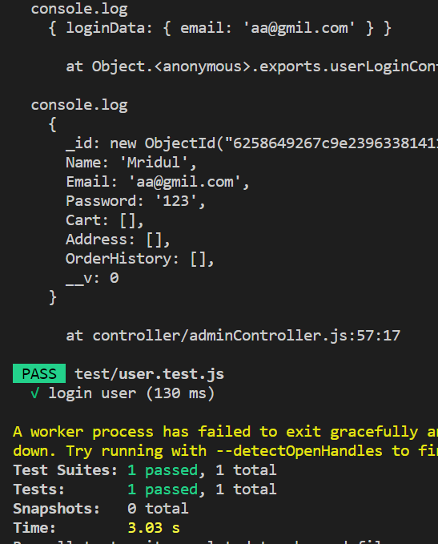
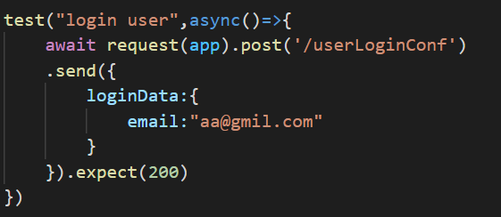
Here, the login for the customers on this app is being tested. After testing, it is found that the customer can successfully login .
Test Case
Output

Slide 5
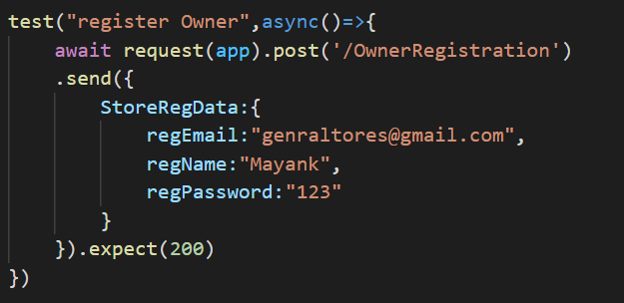
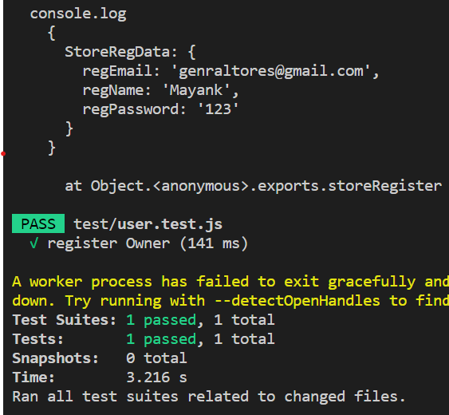
Here, the registration for the store Owners on this app is being tested. After testing, it is found that the owner can successfully register.
Test Case
Output

Slide 6
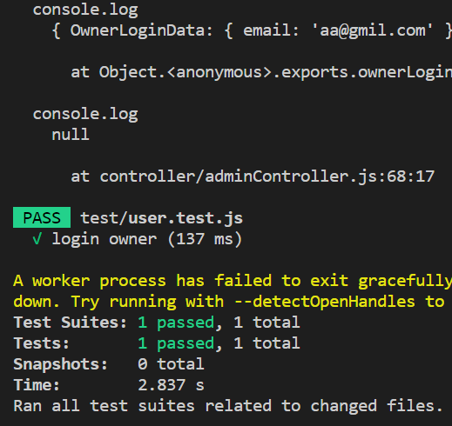
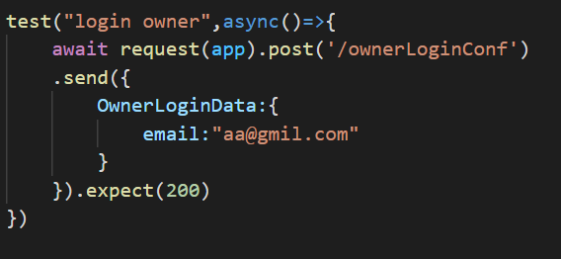
Here, the login for the store owner on this app is being tested. After testing, it is found that the store owner can successfully login .
Test Case
Output

Slide 7
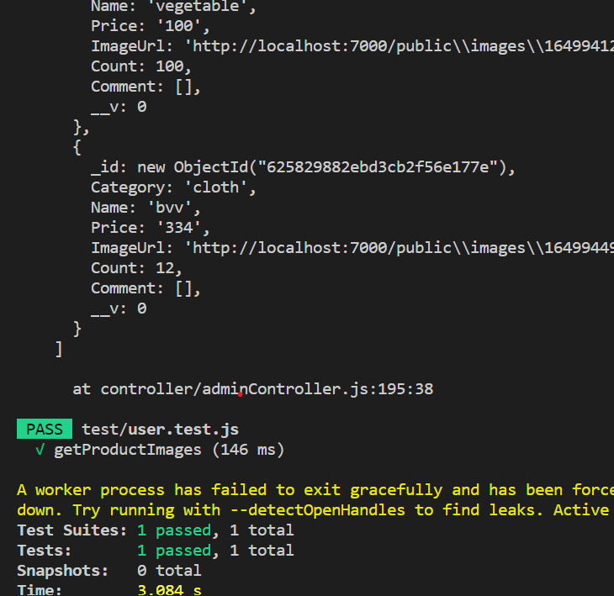
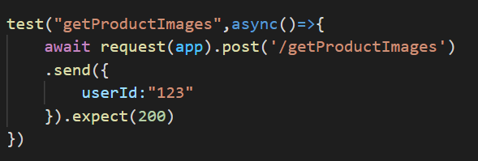
Here, It is being tested if the images of all the products ae being fetched or not.
Output
Test Case

Slide 8
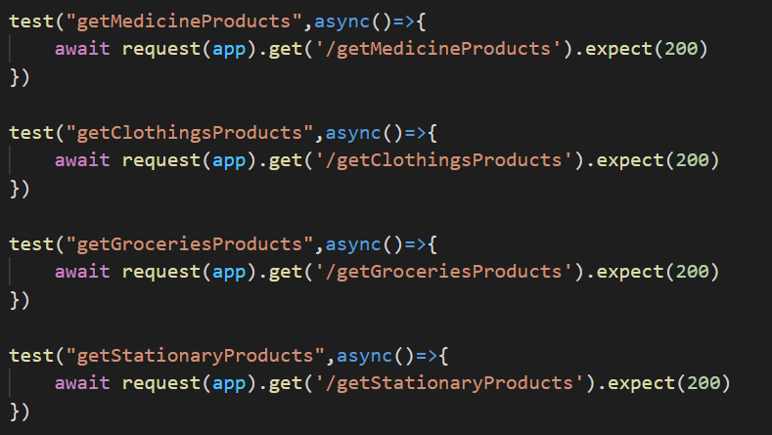
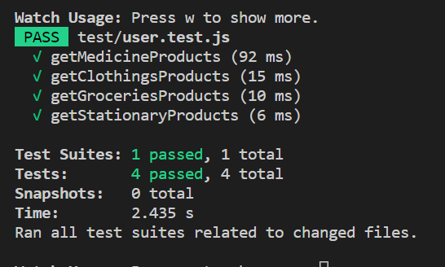
Products of each categories are being tested to be fetched. The test case passes here.
Test Case
Output

Slide 9
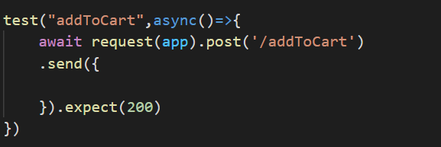
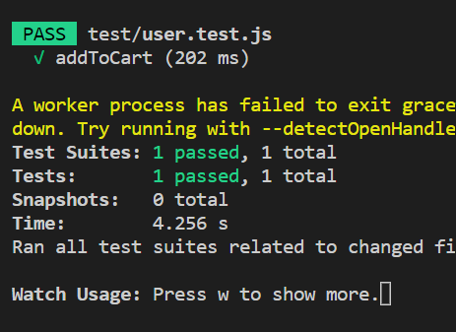
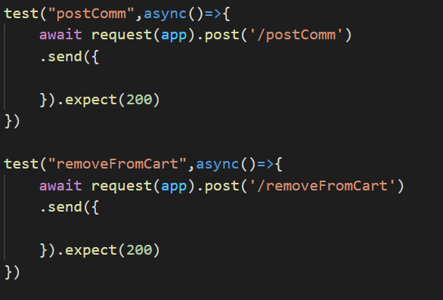
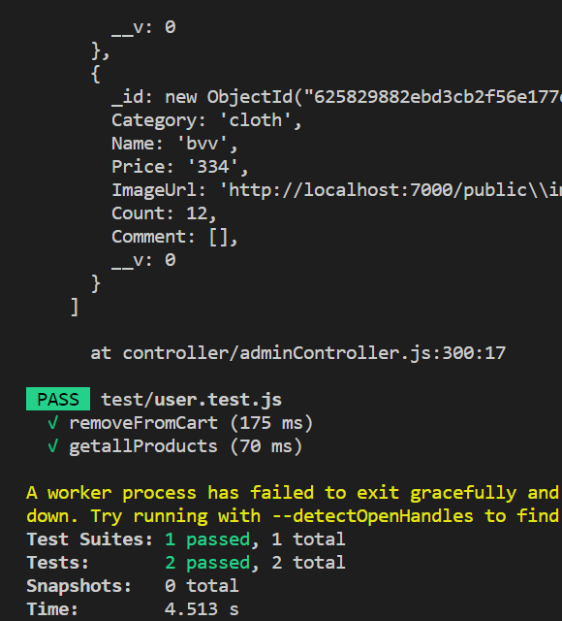
Output
Test Case
Functionalities like add to cart , and posting comments as well as the functionality to remove any product from the cart is being tested here. The testing is passed for all test cases

Slide 10
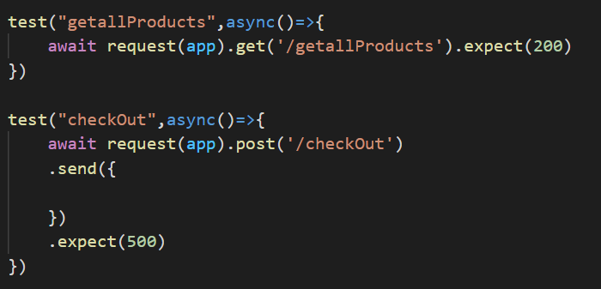
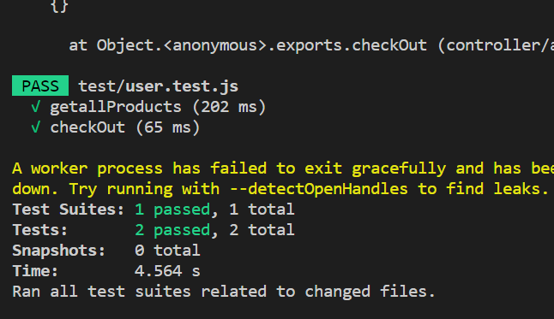
Here, it is being tested if all the products are being fetched or not. The test results are successful
Another test case is run for testing the checkout functionality where a user can checkout and buy the products in the casrt. The test result here ais successful as well .
Test Case
Output

Slide 11
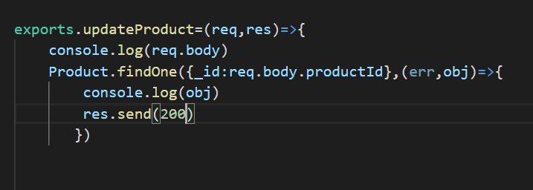
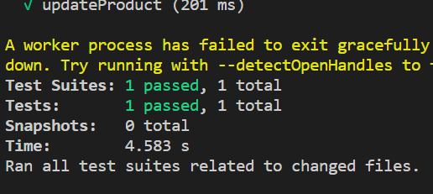
Here, the functionality in which the store owner can update his/her product is being tested. The result of this test case is successful.
Test Case
Output

Slide 12
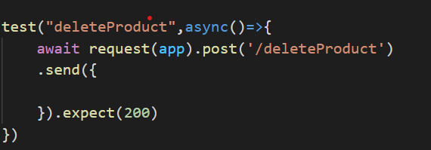
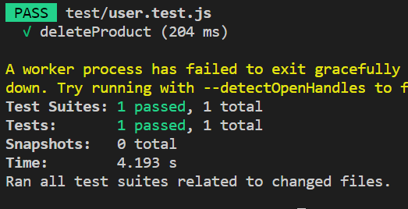
Here, the functionality in which the store owner can delete his/her product is being tested. The result of this test case is successful.
Test Case
Output

Slide 13
As according to the outputs of every testcase it is evident that all test cases have passed!!!

Slide 14
Thank You!!!
Team Members:
Mridul Mayank 1901114
Prabhat Kumar Rajak 1901139
Navneet Ranjan 1901118
Nikita Gupta 1901121

